Slide 1
TITLE OF THE PROJECT:
Degree detective

Slide 2

PRESENTED BY THE STUDENTS OF K21WB:
PRABHAT SHARMA (REG NO: 12109008)
DARESH KUMAR SAH (REG NO: 12104224)
ADARSH KUMAR (REG NO: 12104303)
Under the guidance of Dr. Ranjith Kumar

Slide 3
Scope of this project:
The world is a global village today and people are moving from one part of the world to another part of the world for business.
One country’s weather forecast is different from another country. In this situation, we have to spot on while converting temperature.
The project scope may include the following components:
  User interface design: The project should have a simple and intuitive interface that allows users to enter the temperature value and select the input and output scales.
  Temperature conversion algorithm: The project should include an algorithm to convert temperature values from one scale to another. The algorithm should be accurate and efficient.
  Error handling: The project should include error handling mechanisms to ensure that the user inputs valid temperature values and selects valid input and output scales.
  Unit testing: The project should include a set of unit tests to verify the correctness of the conversion algorithm and error handling mechanisms.
  Deployment: The project should be deployed to a suitable platform, such as a web server or a mobile application store, to make it accessible to users.

Slide 4

PROJECT DESCRIPTION
The Temperature Convertor is one of the updated program which is created with all the possible features and actions to perform according to the user needs.
While we are creating the Program, the first thing came to our mind is to make it user friendly and also get accurate calculation of temperature

Slide 5
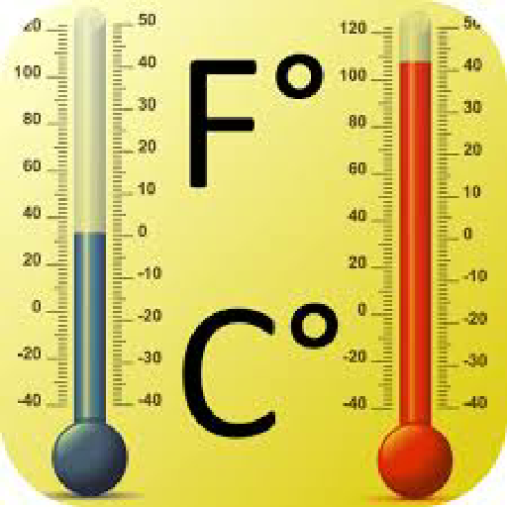
PROJECT DESCRIPTION
The three scale of temperature conversion measurement have been included here are Celsius, Fahrenheit and kelvin.
Kelvin is the temperature scale devised and used to measure temperature from melting point of ice (0 deg) down to absolute zero/
Celsius and Fahrenheit are mainly used to measure temperatures from melting point of ice and up.

Slide 6
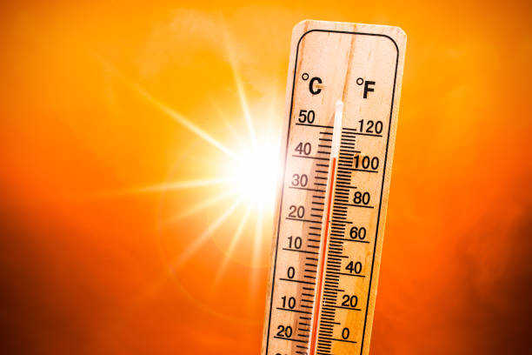
PROJECT DESCRIPTION
Formulas for converting temperature from F to C:
C = (F-32)/1.8
Formula for converting temperature from C to K:
K =(273.15+C)
Formula used for converting temperature from C to F:
F =(C*1.8)+32

Slide 7
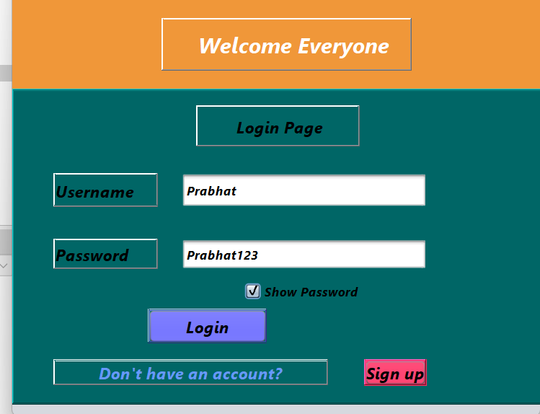
PROJECT DESCRIPTION
In this project, we have total of 6 modules:
Login page:
When we will run the program, the first frame that will appear is the login page.
It will simply ask the username and password from the user, and if the username or password is wrong, it will show us a popup message regarding the wrong details.
If the details filled by the user are correct it will take us to the dashboard.
If the user does not have any account, he/she may create a new Account by simply clicking on “Sign up” button.

Slide 8
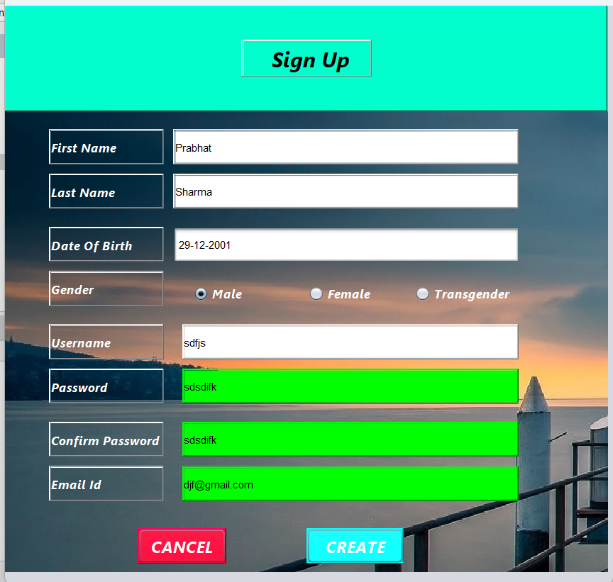
PROJECT DESCRIPTION
Sign Up:
As said earlier, If the user does not have any account, he/she may create a new account by filling all the mandatory details such as “first name”, ”last name”. “DOB”, “username and password”
If the user skips any detail(s) and try to create an account, a pop up message will be generated that he have to fill all the details given in the form.
The password and confirm password should match otherwise it will lead to an error and account will not be created.
The email id should ended with “@gmail.com” otherwise , the account will not be created.
After filling all the mandatory details and creating the account, the user will be taken to the dashboard.

Slide 9
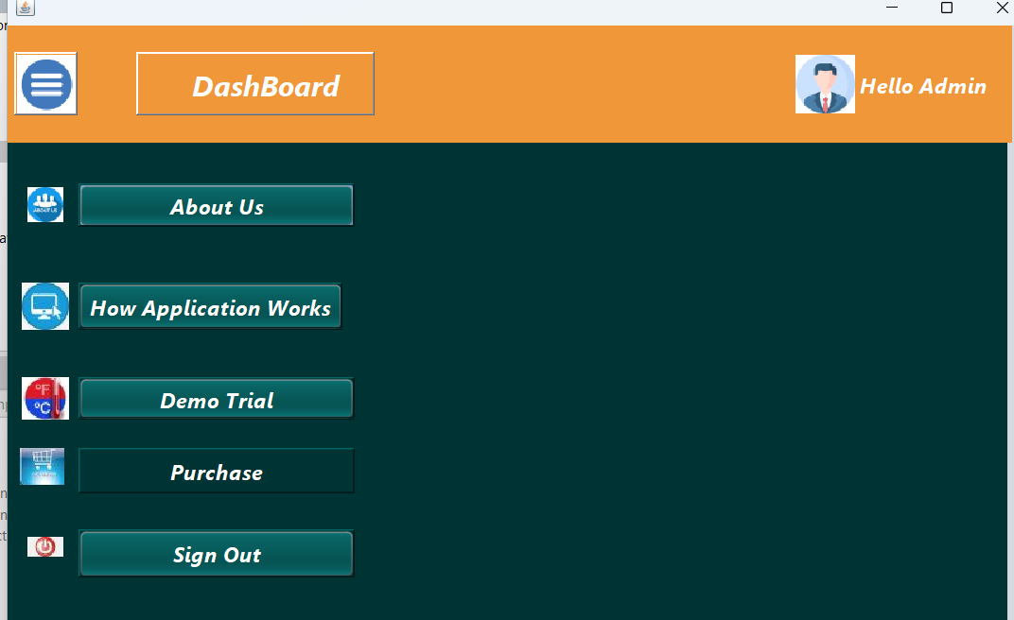
PROJECT DESCRIPTION
Dashboard:
After login to the account, the user will be taken to the dashboard where all the details are available regarding the GUI.
There are many sections provided here like
“ About us”, “ Working of the application”, “ demo trial”, “ purchase” , “sign out”
Clicking on any section, the user will be taken to that frame.
Now lets look to the further modules one by one:

Slide 10
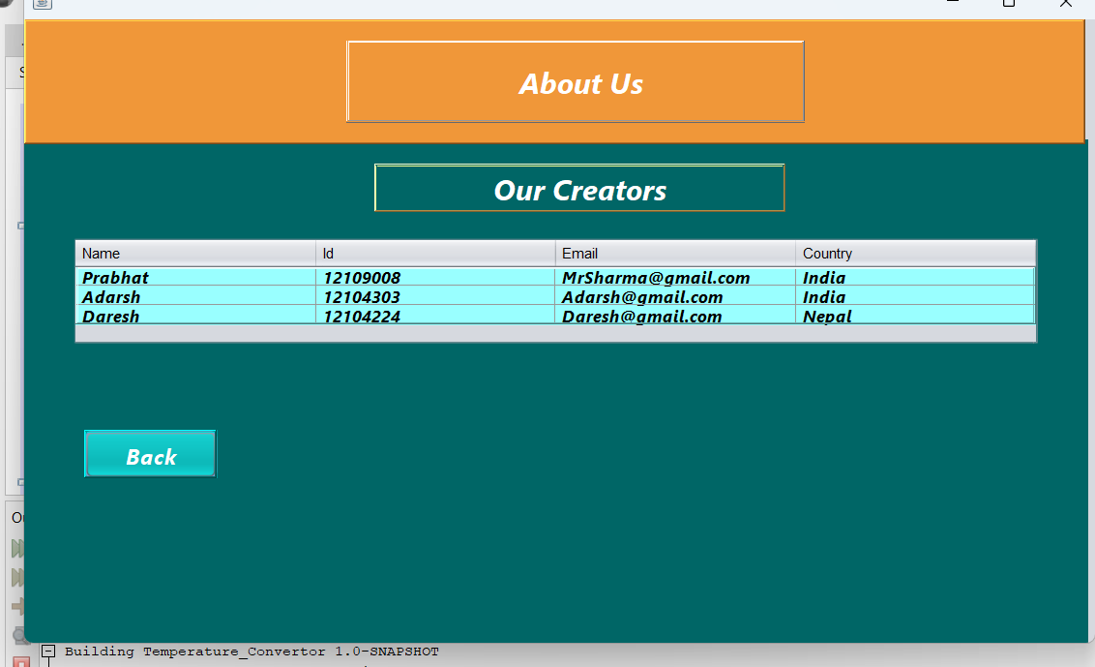
PROJECT DESCRIPTION
About us :
This frame will simply tell some details about the creators of this project in a tabular format.
Here a button has been used named “Back” which is linked with the dashboard, which when clicked will take the user again to the dashboard.
Now lets look to the next Frame:

Slide 11
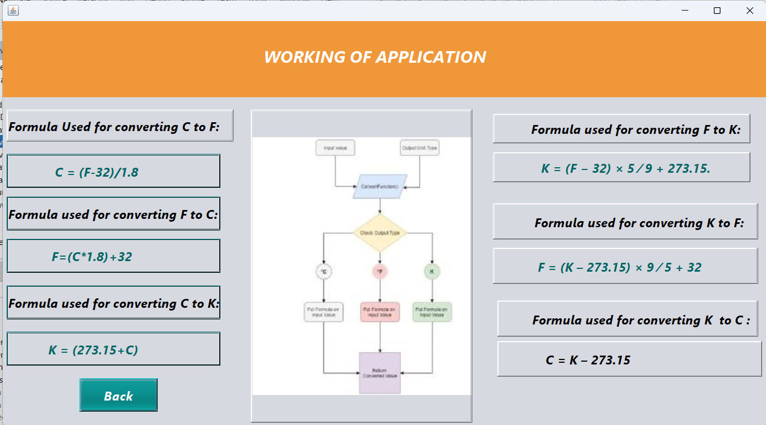
PROJECT DESCRIPTION
Working of the application:
Any user who is using the application should be aware that how is actually the interface is working.
So, we have provided an Er diagram in this frame and some formulae regarding the conversion so that the user can also verify it that whatever the conversion the application is doing is correct.

Slide 12
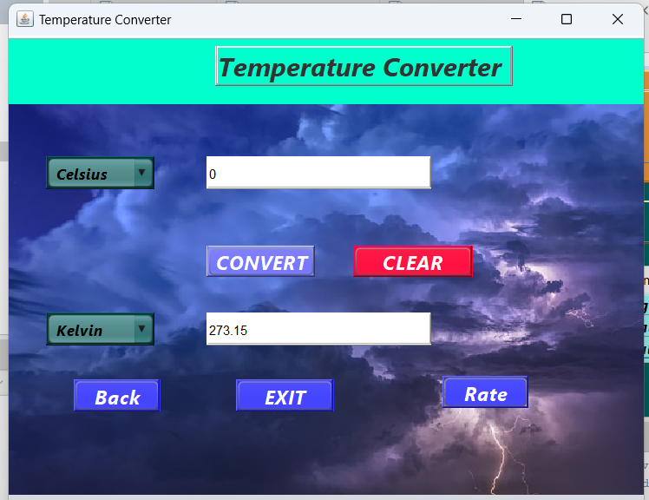
PROJECT DESCRIPTION
Application:
There is a frame called “Demo Trail” which will take the user to the main application.
There the user can convert the temperatures as per his/her wish. In this 3 scales of temperatueres given using JcomboBox : Celsius, Fahreinheit and kelvin.
The first textfield will take the input from the user and displays output to the second textfield.
Here a “Rate” button is also there which will take the user in the “Submit Feedback” frame when clicked, Lets look about that in more detail:

Slide 13
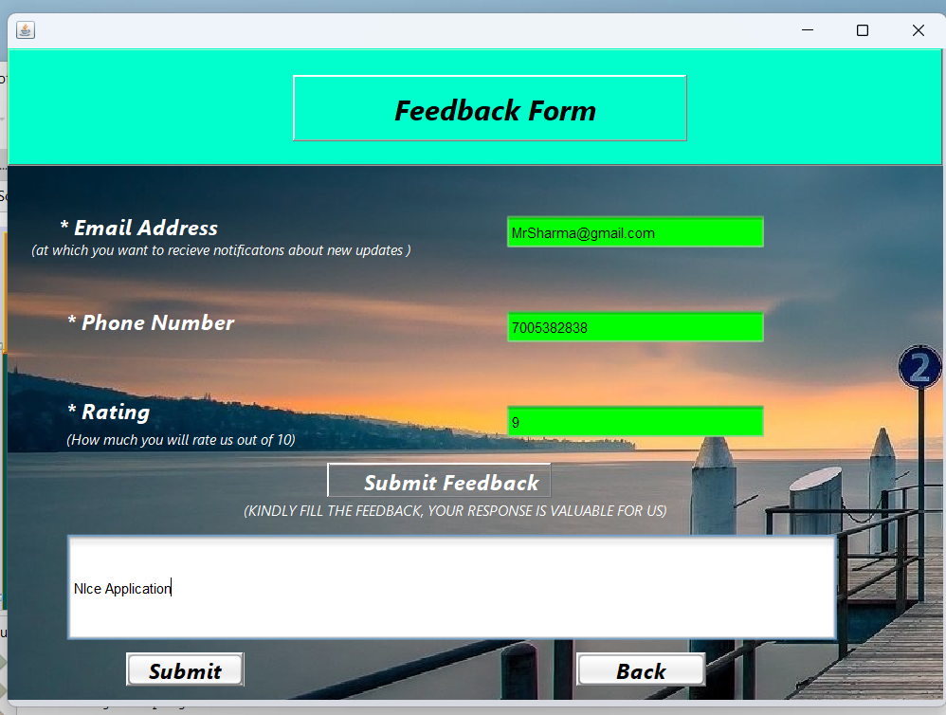
PROJECT DESCRIPTION
Feedback:
After clicking on “ Rate button” the user enter into a new frame called “ Feedback form” through which the user can give his opinions to the project team.
The user have to enter all the details like his email id, phone number to submit his/ her feeback.
The email id must end with “@gmail.com” and mobile number must be of 10 digits otherwise it will show an error.
After filling all the details, and clicking on the “Submit” button , a popup message will be displayed which will show the date and time at which the user has submit the feedback form.

Slide 14
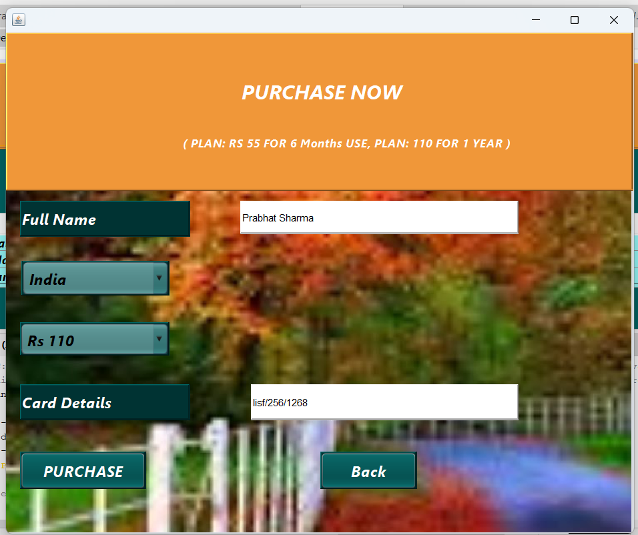
PROJECT DESCRIPTION
Purchase:
Lets talk about another module “Purchase”
In this module the user if find the application useful, will be able to purchase it for his use.
User just have to enter his full name, and card details , and have to select his/her country and select plan and then have to click on “purchase now” button.
A popup message will be shown with the time and date the user has purchased the application.
NOTE: If any of the details is skipped by the user, he/ she will not be able to buy it. (All details are mandatory).

Slide 15
Now lets look all these frames with the help of Smart Art:
Step 1 Login
Or
Sign up
To use this application he/she has to login to the dashboard.
Step 2 Dashboard
In dashboard, user will find total 6 modules:
Step 3 short description about all frames
About us: will provide info about the creators
If account is not there, he/she can create a new account by clicking on signup button
About us
Working of application
Demo trial
Purchase
Working: Will help the user to understand the working of the application
Demo trial: will help the user to know whether it is user-friendly for him or not
Purchase: If user is satisfied with its working he/she can purchase it
Feedback: User can give his opinions to the team so that we can improve it.

Slide 16

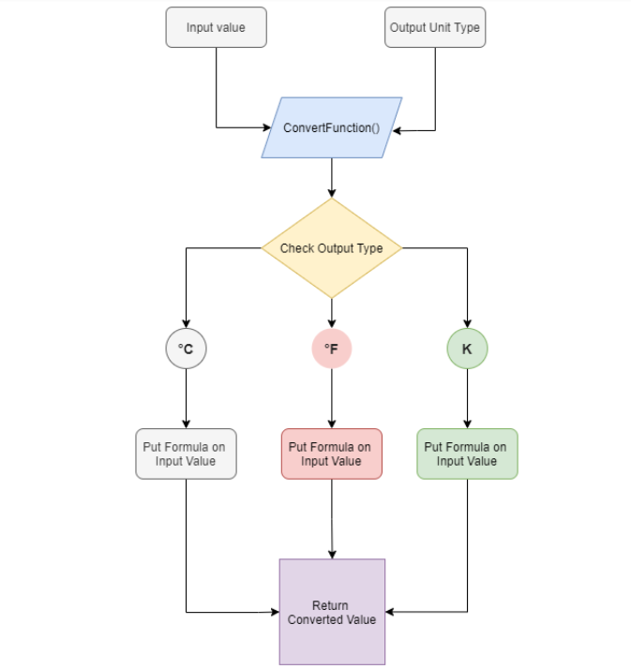
Er diagram to understand it better:

Slide 17
Outcome of the project:
The outcome of a temperature converter depends on the input temperature and the units of measurement used in the conversion. Generally, temperature converters are used to convert temperatures between different units such as Celsius, Fahrenheit, and Kelvin.
For example, if you input a temperature of 25 degrees Celsius into a temperature converter and select the option to convert it to Fahrenheit, the outcome would be 77 degrees Fahrenheit. Similarly, if you input a temperature of 32 degrees Fahrenheit and select the option to convert it to Celsius, the outcome would be 0 degrees Celsius.

Slide 18
Conclusion:
In conclusion, the Temperature Converter project aimed to develop a user-friendly application that enables users to convert temperatures from one unit to another.
The project was successful in achieving its objective by providing users with a simple and intuitive interface that allows them to quickly convert temperatures between Celsius, Fahrenheit, and Kelvin.
The development process involved using programming language Java. Overall, the Temperature Converter project serves as a useful tool for individuals who need to convert temperatures regularly.
The application's simplicity and ease of use make it an excellent choice for those who want a hassle-free way of converting temperatures. As such, the Temperature Converter project is a valuable addition to the field of temperature conversion and can be used by anyone, anywhere, anytime.

Slide 19

Thank You

